Slide 1

Is this kithul treacle real?
FINAL-YEAR RESEARCH PROPOSAL
A low-cost AI system to detect sugar in Sri Lankan kithul treacle using a phone camera, a cheap sensor and a thermal camera.
Notes:
Open warmly: kithul treacle is a famous Sri Lankan sweetener, but a lot of what is sold is secretly mixed with sugar. Our project builds a cheap, fast way for anyone to check if it is real. Three of us each build one testing method.

Slide 2


A world-heritage sweetener, often faked
THE PROBLEM
Kithul treacle (kithul pani) is made from the sap of the kithul palm. In December 2025, UNESCO named kithul tapping part of the world’s cultural heritage.
PURE
Natural kithul sap, boiled down. Rich taste, higher price.
Many sellers mix cheap sugar syrup into the treacle and sell it as pure.
MIXED
Today the only reliable check is a slow, costly lab test. Ordinary buyers, shops and small sellers simply cannot do it.
Add cheap sugar syrup. Looks similar, costs less, sold as “pure”.
Notes:
Kithul treacle is prized and now UNESCO-listed. But adding sugar is common. The hard part: the only real test today is a lab test, which normal people cannot use. That is the gap we fill.

Slide 3




Who the fakes hurt
WHY IT MATTERS
Buyers
Honest tappers
Pay a high price but often get a mostly-sugar product.
Lose income because faked treacle is cheaper to make.
Exports
Health
Foreign buyers lose trust, so exports stay small.
People who choose kithul to be healthier may eat mostly sugar.
Notes:
Four groups are harmed: buyers, honest tappers, the export trade, and people who picked kithul for health reasons. This is why a cheap, trustworthy test is worth building.

Slide 4
PROBLEM STATEMENT
There is no fast, low-cost, AI-based way to detect and measure sugar in kithul treacle and no dataset to build one.
Notes:
This is the single sentence the whole project answers. Pause here so the panel takes it in.

Slide 5

What others have done
EXISTING RESEARCH
ON KITHUL lab methods only
ON HONEY cheap AI already works
Seneviratne & Dissanayake (2016) surveyed 304 tappers; sugar is added mostly when sap is poor or watery.
Cheap light sensor + ML detected sugar syrup in honey with 91-98% accuracy.
Somasiri (2015) lab chemistry (HPLC, GC-MS) and a chemical test kit for cane sugar.
Thermal camera + deep learning reached about 99% on mixed honey.
Wijesinghe & Rathnayake (2021) pure vs 5–25% sugar differ in Brix, pH and conductivity. No proper test method yet.
Honey has the same problem - and cheap tools solve it.
Notes:
Two sides. Kithul research is all lab-based. Honey, which has the exact same sugar problem, is already solved with cheap sensors and cameras. That contrast points straight at our opportunity.

Slide 6




The empty space we fill
THE RESEARCH GAP
Only lab methods
Not tried on kithul
No dataset exists
Kithul testing is slow, costly and needs experts.
Cheap AI works for honey, but nobody applied it to kithul.
No images, sensor readings or videos of kithul treacle.
Our contribution: the first low-cost AI method and the first open dataset for kithul treacle.
Notes:
Three reasons this is open: testing is lab-only, cheap AI has never been tried on kithul, and no dataset exists. Building that dataset is itself part of our contribution.

Slide 7






Three cheap ways to spot a fake, then combine them
OUR APPROACH
Phone camera
Sensor device
Thermal camera
Combined model
Colour, clarity and how the treacle flows.
Light bands and electrical conductivity.
How the treacle heats up and cools down.
One answer: pure or mixed, and how much sugar.
Then test on real shop-bought treacle and confirm with a lab, to prove it works in the real world.
Notes:
The core idea: three cheap sensing methods, each run by one member, all tested on the same samples, then fused into one decision. We finish by testing on real market treacle and checking against a lab.

Slide 8
We build our own — no dataset exists
THE DATASET
Pure treacle
From trusted tappers, or via the Kithul Development Board
Mixing levels
Market samples
From shops, supermarkets and roadside sellers
0 · 5 · 10 · 15 · 20 · 30 · 50%
Sugar syrup
We make it ourselves, so we know the exact mix
Confirmed by
A food lab — a university chemistry dept. or the ITI
Roughly
Small-data help
Transfer learning and data augmentation
400–1,300
measurements per method
Notes:
Because nothing exists, building the labelled dataset is a real contribution. The key is knowing which samples are truly pure, so a food lab confirms them. Mixing levels go from 0 to 50 percent so the model learns to estimate amounts, not just yes/no.

Slide 9



One method each, tested on the same samples
THE TEAM
MEMBER 1
MEMBER 2
MEMBER 3
Phone camera
Sensor device
Thermal + fusion
Images and flow videos from an ordinary smartphone.
A cheap handheld light + conductivity tester.
Heat-pattern test, plus the combined model.
→ A phone-app test for consumers
→ A pocket tester for shops
→ The most accurate system
Notes:
Each member owns a full pipeline: their own capture setup, their own data, their own model. All three test the same samples, so the results can be fairly compared and then combined. The next three slides go one per member.

Slide 10



Can a smartphone catch a fake?
MEMBER 1 · PHONE CAMERA
What it does
Models & output
A small light box keeps the lighting the same every time
Photos measure colour and clarity
Flow videos show thickness — sugar changes how it drips
Computer vision tracks the drop’s speed and spread
CNN for the photos
CNN + LSTM for the flow videos
Predicts pure/mixed and the sugar %
Output: a phone app anyone can use.
Key tool: OpenCV, MobileNet/EfficientNet, TensorFlow Lite, Flutter. Keep lighting, amount and temperature the same every time.
Notes:
Member 1 turns a normal phone into a tester. The light box and fixed routine matter more than the model — most errors come from changing light or temperature, not weak AI.

Slide 11

Can a cheap gadget match a lab?
MEMBER 2 · SENSOR DEVICE
What it does
Models & output
Build a handheld device on an ESP32 board
A multispectral light sensor (≈18 colour bands) reads the “light fingerprint”
A conductivity probe reads natural minerals — sugar has few
Also logs temperature, which affects readings
PLS and SVM (classic) vs. a 1D-CNN
Predicts pure/mixed and the sugar %
Output: a low-cost pocket tester for shops and collectors.
Key tool: AS7265x sensor, Arduino/ESP32, scikit-learn. Calibrate before each session and clean the probe between samples.
Notes:
Member 2 builds hardware. The research question is whether a cheap device can give lab-like answers. If yes, small sellers can check quality themselves.

Slide 12



Heat patterns, and joining it all
MEMBER 3 · THERMAL + FUSION
What it does
Models & output
A thermal camera (cheap MLX90640, or a borrowed FLIR) sees heat, not light
Records how each sample heats up and cools down
Pure and mixed treacle hold heat differently
ConvLSTM / 3D-CNN on the heat videos
Builds the combined model using all three methods
Grad-CAM & SHAP explain why it decided
Output: the most accurate system, for exporters and certifiers.
The fusion model joins all three methods — like asking three experts and combining their answers for one reliable result.
Notes:
Member 3 adds the thermal method and, importantly, builds the fusion model that combines all three. The explainability part builds trust, which exporters and certifiers need.

Slide 13

The right test for each user
WHAT WE DELIVER
Level | Who uses it | Method
Cheapest | Consumers | Phone camera only
Middle | Collectors, shops | Handheld sensor device
Best | Exporters, certifiers | All three methods combined
Main question answered: what is the cheapest method that is accurate enough for each user? Plus the first open kithul dataset.
Future work: an assistant to help tappers make better treacle, and a QR code to trace each bottle.
Notes:
This is the payoff: not just one accuracy number, but a practical recommendation of the cheapest good-enough test for each kind of user, plus a reusable dataset. Mention the two future-work ideas to show the bigger picture.

Slide 14
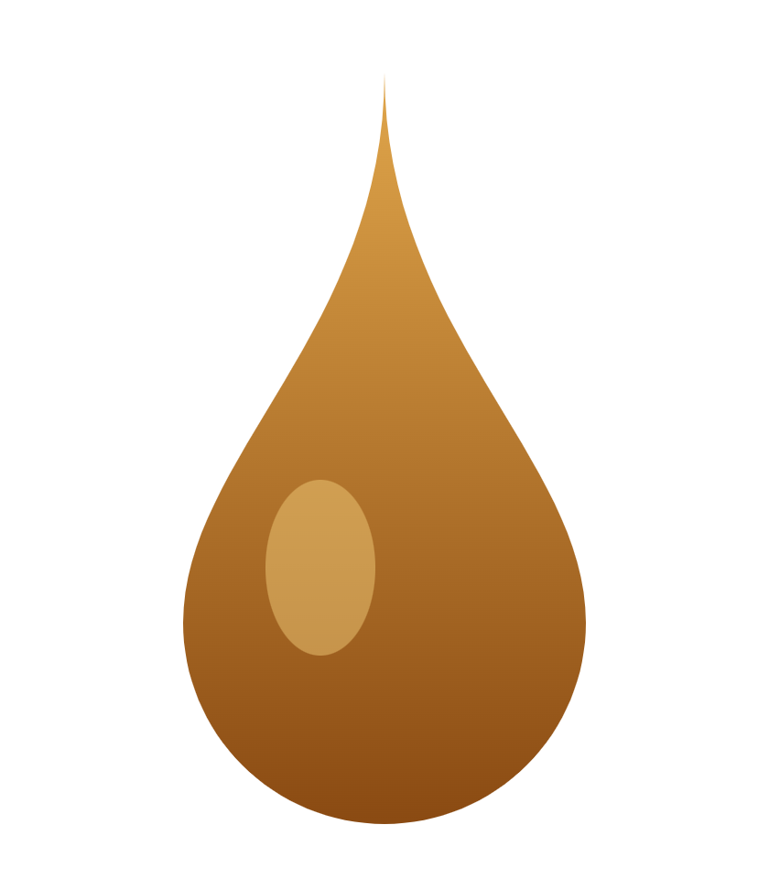
Questions & feedback
THANK YOU
Next step: find a food lab partner and collect the first pure samples.
[Member 1] · [Member 2] · [Member 3] · [email]
Notes:
Close by inviting questions. Likely one: “How do you get pure samples?” Answer: buy direct from trusted tappers and have a food lab confirm purity before we use them.

